Slide 1
Input Analysis of PPG Data
Nick Zullo

Slide 2
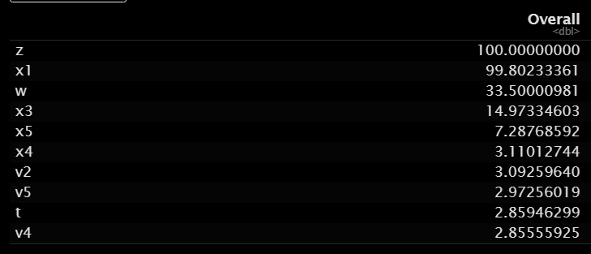
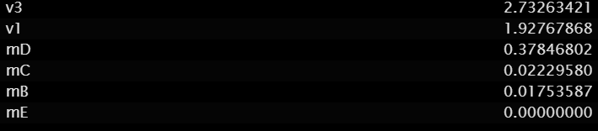
Most Important Inputs
This table shows the importance level of each input on a scale from 0 to 100, with 100 being the most important. We see that the chemistry variables provide the most data to the model’s performance. The manufacturing inputs are not nearly as important, and especially the machine type, which is near 0 in importance.
Input x2 was not used in the model because performance was improved when it was neglected.
Input x2 is highly correlated with x5, and is not needed in the model

Slide 3
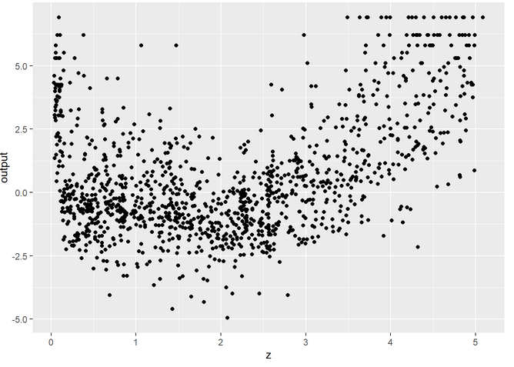

Trends of Important Inputs
This is a graph of the logit transformed response, given as output = $log⁡(\frac{p}{1−p}),$where p is the percentage of the coating that has degraded, graphed with z, the most important input. We can see a clear parabolic trend in this data. Noise is present in the trend, but it resembles the graph of :
$y=\frac{3}{2}{\left(x−2\right)}^{2}−2$

Slide 4
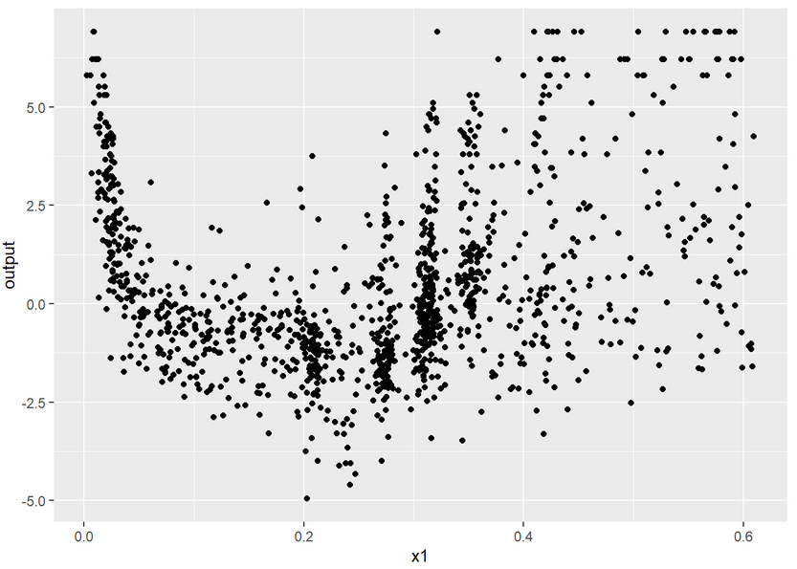
Trends of Important Inputs
This is a graph with the same y axis variable, using x1, the second most important input, as the x axis. We can see another clear parabolic trend. This one begins tight, with little noise, and provides great information for the model to learn with. After x1=.4, the data is more spread, and other inputs like z will provide better information.

Slide 5
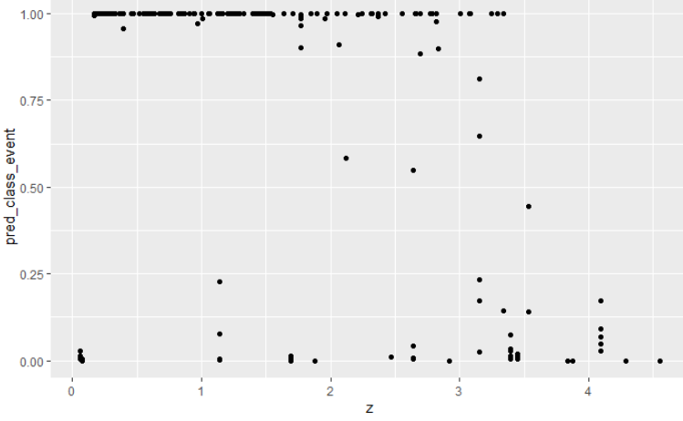
Trends of Important Inputs
The y axis of this graph is probability that the current input combination results in a coating that will corrode less than 33%, being 1, and the probability it will corrode more than 33%, representing 0, versus the most important input, z.
It is hard to determine if a relationship exists in this data, but it seems to be able to classify the output values well from z=0 to z=1 and z=3.5 to z=5

Slide 6
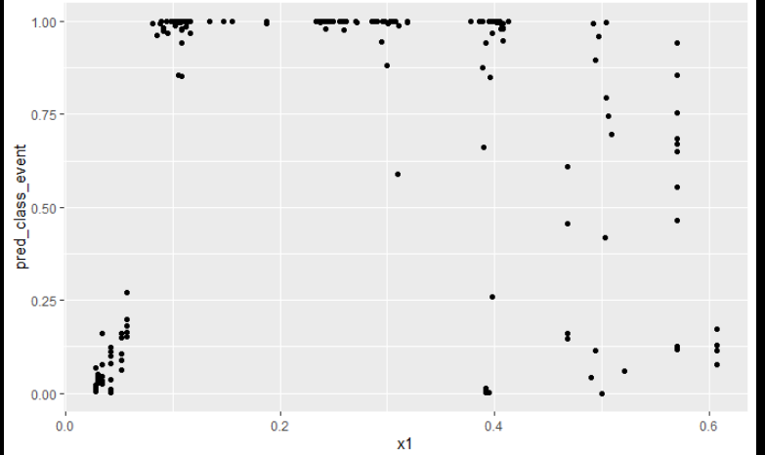
Trends of Important Inputs
Here we see the same y axis, but graphed against x1. We can clearly see the benefit the tight trend we saw in the earlier graph, as before x1=.4 we can clearly classify the probability. Once noise is added into the data after x1=.4, we see the probability is more scattered and uncertain.

Slide 7
Recommendations
The chemistry inputs, and the features that can be derived from them, are the most important at minimizing the corrosion of the surface.
If possible, more raw inputs should be used
More derived features from the raw inputs should be created
Manufacturing machine provides little to no impact
The machine that works fastest and easiest should be used, as the quality of coating is nearly unchanged based on machine
Manufacturing inputs provide some value, but should not be prioritized over finding more chemistry inputs

